Slide 1


Miracle Educational Society Group Of Institutions
Resume Screening
Under the guidance of :
Mr.Atchyuta Rao
Assoc.Prof
Team : Varupula Kiran(196C1A05A6)
Yellapu Aarthi(196C1A0573)
Pyda Rohit Sai(196C1A0578)
Batch no : 12
Department : CSE

Slide 2

Table Of Contents
Abstract
Introduction
Existing System
Proposed System
Literature Survey
System Architecture
Uml Diagrams

Slide 3

Abstract
In a typical service organization, professionals with a variety of technical skills and business domain expertise are hired and assigned to projects to resolve customer issues. This task of selecting the best talent among many others is known as Resume Screening. People spend hours writing and formatting the perfect resume, hoping it will be read by a talent acquisition professional and, eventually, help them land a job interview. Unfortunately, around 75% of resumes submitted are never seen by a human eye. Due to the high number of applicants and resumes submissions tojob postings, manual resumesscreening processes become tedious, ineffective and time consuming for talent acquisition professionals. Therefore, standardized automated screening methods are necessary to categorize qualified from unqualified candidates based on their background, education and professional experience faster, with more efficiency and more accurate results to streamline hiring processes.

Slide 4
Introduction
It can be difficult to identify the most qualified candidates from a large pool of applicants. Lot of shortlisted resume turns out to be inappropriate (false positives)
Resume screening can be time-consuming and potentially biased if not done carefully.
There is always the risk that a promising candidate may be overlooked if their resume does not meet all of the criteria for the job (false negatives).
Resumes can be long and detailed, making it difficult to identify relevant information.
Resumes may not always reflect a candidate’s true skills and abilities.
Candidates may omit important information or downplay their qualifications in order to appear more qualified than they actually are.

Slide 5
Existing System
The process of hiring in most of the organizations is nominal but the allocation of technology/domain after hiring a resource is random, which is a most troublesome and problematic phase for most of the new employees as they will not be able to work in their field of interest. The random assignment is the traditional process used by all the organizations and later on some employees selected from college by conducting some special drives will be given the option to pursue a career in their dream technology/domain, which gives them the drive to learn more and move forward but the proposed model makes all the resources/people to work in their area of interest. To this day any company is not using a fully automated way to choose which is perfect for which position.

Slide 6
Proposed System
The main aim of our project is classify resumes based on their category. Our work is different than that of earlier proposed systems, as in most of the existing system a job is recommended to the candidates based on their resume content, it leads a low classification accuracy. In order to improve it, we proposed a system which works as classifying the resume in their classes. The first step is to clean our resumes and removed all the unnecessary data in the resumes and the next step is to classify entire dataset based on the categories available in the dataset. In the result we display visualization of the categories and which category is high in the resume. It will help the companies in both time and man power management and it is effective process for hiring people

Slide 7
Literature Survey
There have been over 50000 online recruitment sites which ask the job applicant candidates to submit their resumes on their website. In some of these websites, classification techniques for screening the resumes are not even employed. It is the job of the company recruiter to go through all the candidate resumes manually. This task is unassumingly daunting for the recruiters to select the most capable candidates for the subsequent rounds of the hiring process. Meanwhile, some recruitment sites have implemented the intelligent concept of automatically rating or classifying the resumes given by the candidates for a particular job position. Some of these websites or web applications are Indeed, Monster.com, Adecco.com, Top resume, Ideal etc. The description of some of these websites including their advantages and disadvantages has been given below in detail. If we discuss one of the case study websites, indeed, resumes can be uploaded by the job applicants on their profile.

Slide 8
This opens up the avenue for the prospective job seekers to apply to various job openings in various companies. Initially, this happened to be a good approach since the recruiters did not feel the pressure to manually go through each and every resume.some of these websites including their advantages and disadvantages has been given below in detail. If we discuss one of the case study websites, indeed, resumes can be uploaded by the job applicants on their profile. This opens up the avenue for the prospective job seekers to apply to various job openings in various companies. Initially, this happened to be a good approach since the recruiters did not feel the pressure to manually go through each and every resume

Slide 9
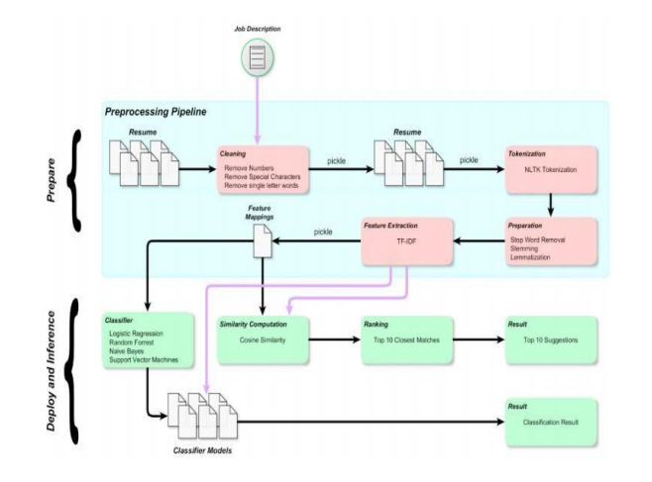
System Architecture And Design

Slide 10

UML Diagrams
A UML diagram is a diagram based on the UML (Unified Modeling Language) with the purpose of visually representing a system along with its main actors, roles, actions, artifacts or classes, in order to better understand, alter, maintain, or document information about the system. As every diagram need not to be included in our project, we tested out what are the best suited diagrams for our project. Some of them are,
1. Use case Diagram
2. Class Diagram
3. State Diagram
4. Sequence Diagram
5. Collaboration Diagram
6. Deployment Diagram

Slide 11
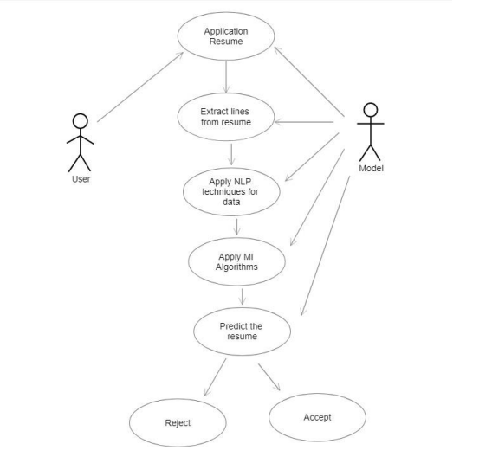
Use Case Diagram
A usage case outline inside the Unified Modeling Language we used in our Project Development is Star (UML) could be a sort of behavioral chart portrayed out by and produced using a Use-case examination. Its inspiration is to gift a graphical layout of the presence of mind gave by a system to the extent performing specialists, their targets (addressed as use cases), and any conditions between those use cases. The most explanation behind a use case diagram is to show what structure limits are played out that on-screen character. Parts of the entertainers inside the system will be diagram.

Slide 12
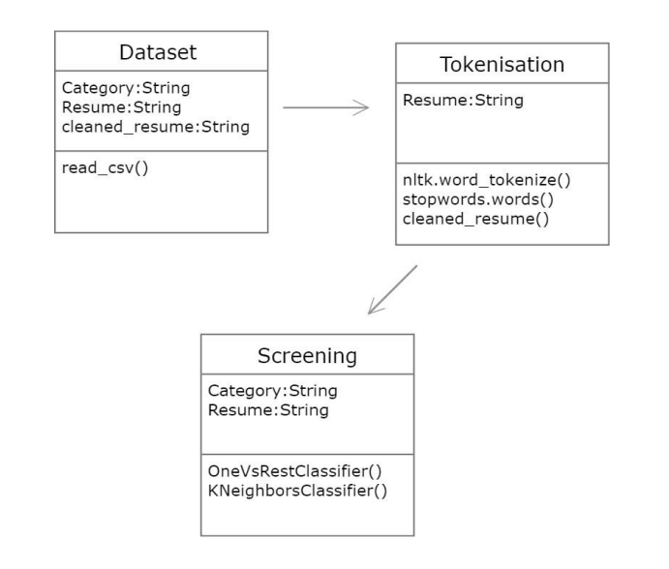
Class Diagram

Slide 13
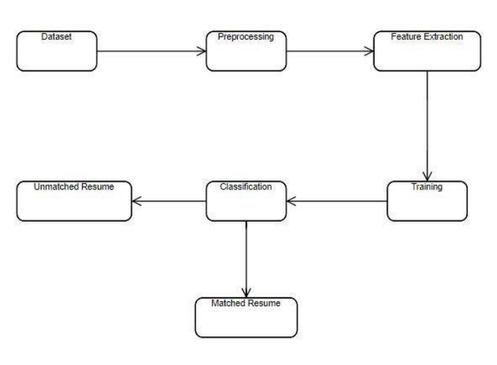
State Diagram
A state diagram is used to represent the condition of the system or part of the system at finite instances of time. It’s a behavioral diagram and it represents the behavior using finite state transitions

Slide 14
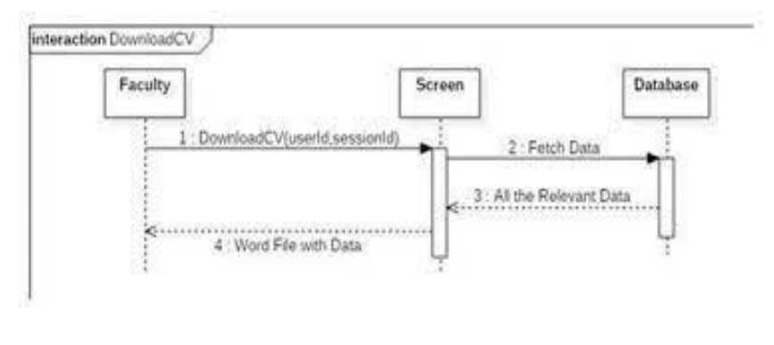
Sequence Diagram
A sequence diagram shows the sequence of messages passed between objects.

Slide 15
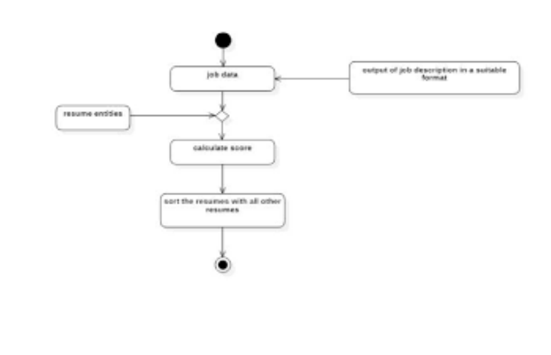
Collaboration Diagram
A collaboration diagram, also known as a communication diagram, is an illustration of the relationships and interactions among software objects in the Unified Modeling Language

Slide 16
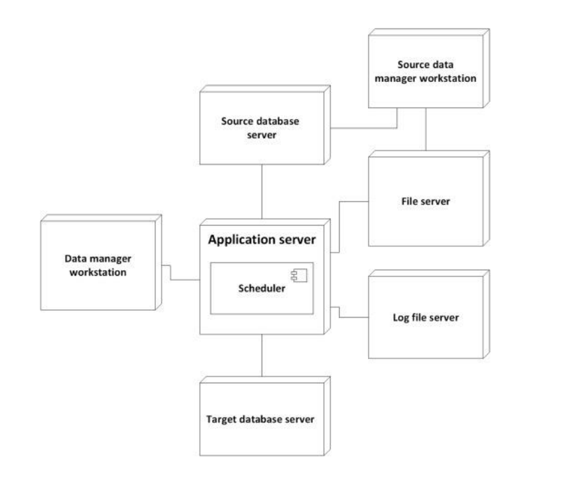
Deployment Diagram
Deployment diagrams are used to visualize the topology of the physical components of a system, where the software components are deployed

Slide 17
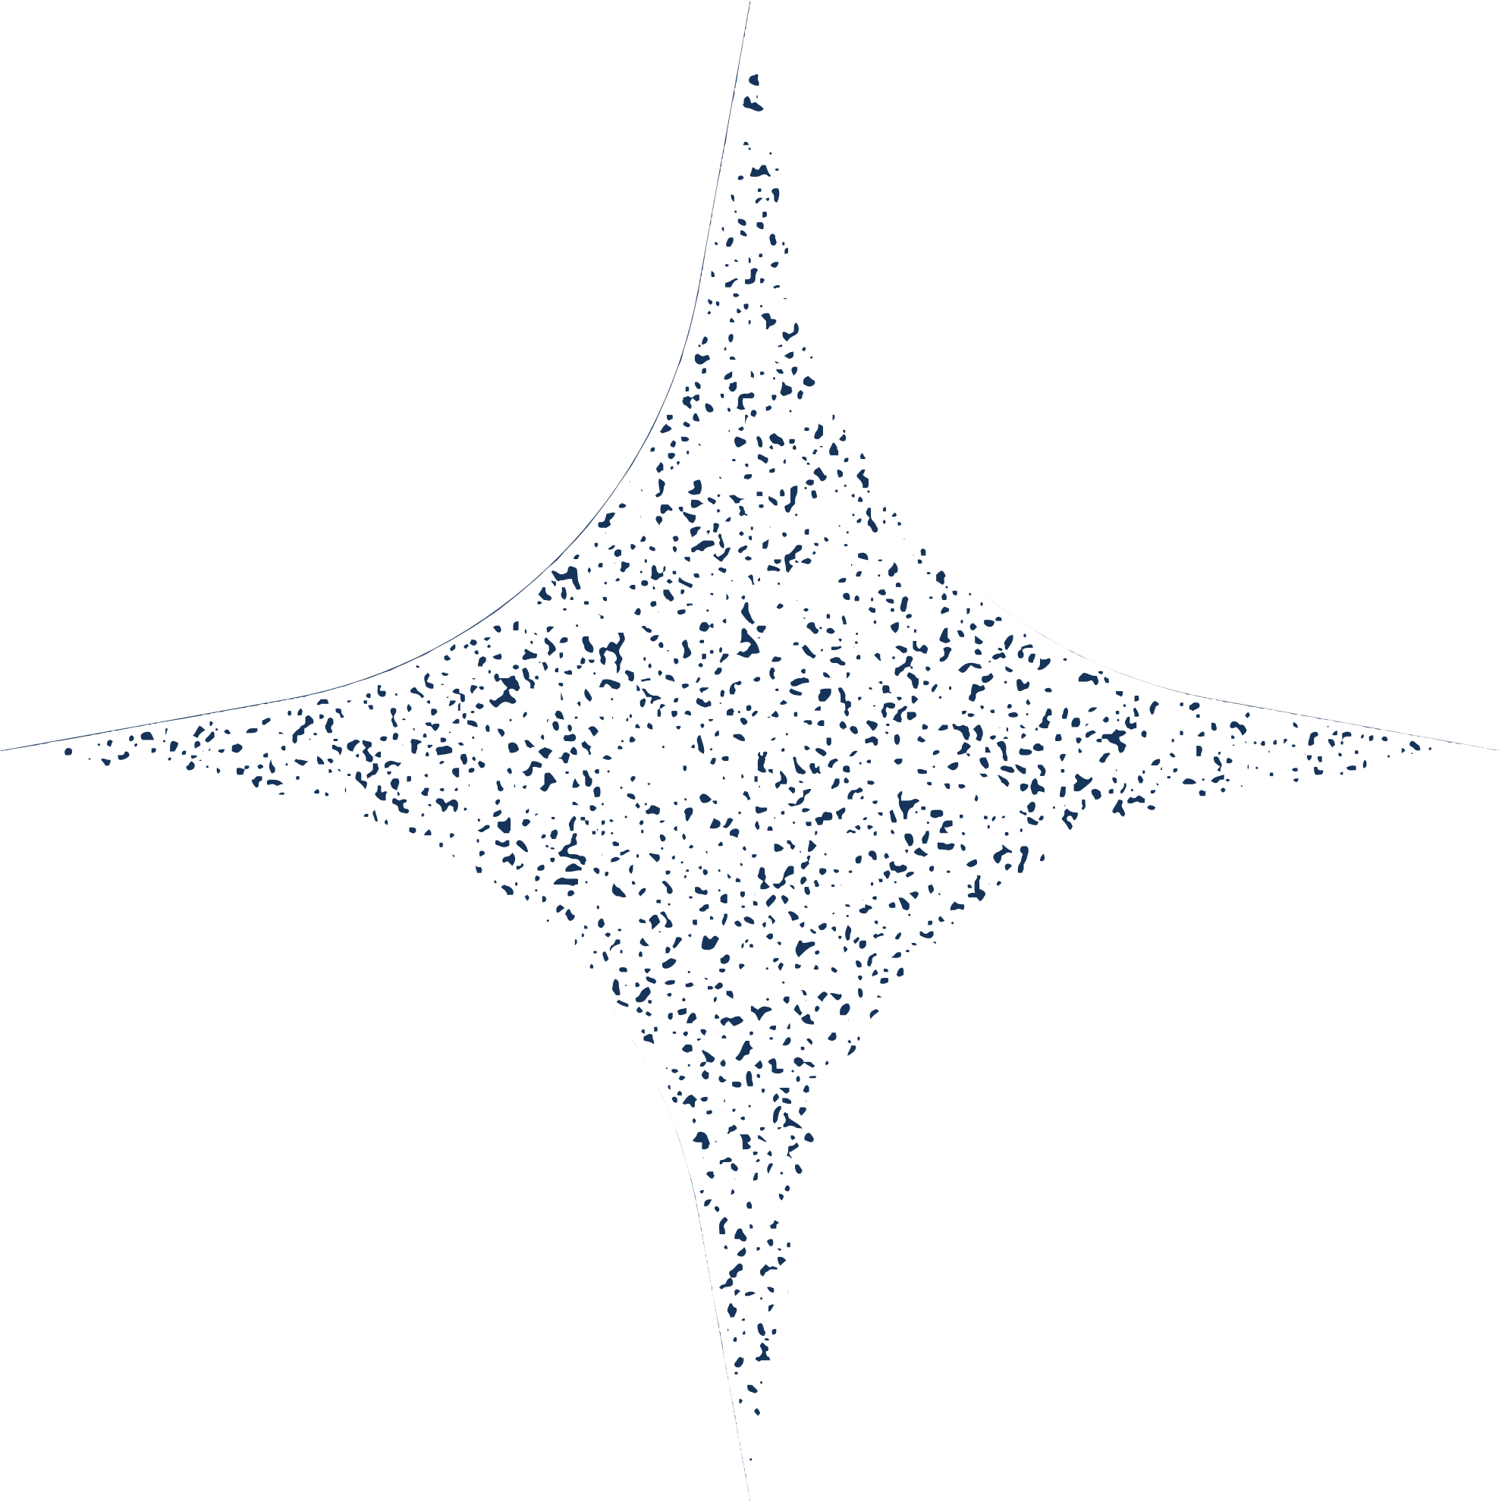
Thank you!

